Slide 1

Exception Handling
Unit 6
Pradeep LN

Slide 2

Exception Handling
Objectives
Error Handling in Conventional Languages
Exceptions
Exception Handling in Java
Exception Hierarchy
Throwable Class
Error and Exception
Types of Exceptions
Throwing Exceptions
Declaring Exceptions per Method
Catching Exception
Designing user-defined Exception classes
Method Overriding and Exceptions
Assertions
Why log?
Java SE Logging API
Severity Levels
Log Hierarchies

Slide 3
Error handling in traditional languages
Exception Handling
Traditional error handling methods include
Boolean functions (which return TRUE/FALSE).
Integer functions (returns –1 on error).
And other return arguments and special values.
int main () {
int res;
if (can_fail () == -1) {
cout << "Something failed!" << endl;
return 1;
}
if(div(10,0,res) == -1) {
cout << "Division by Zero!" << endl; return 2;
}
return 0;
}

Slide 4
Exception Handling
Problems associated with Traditional approach
The caller of the function is notified if the function was executed successfully or not by returning a value.
With this approach, a function can only return a
value to successfully value.
indicate or not
if the function executed and cannot return any other
Since the function returns a value, the caller is not bound or forced to receive the same and can simply ignore it.
Any error handling will be done in a series of if….else blocks, which leads to cluttered code.
With no clear separation of error handling code, maintainability of the code becomes tedious.
Notes:
Traditional approach can not identified which kind of error occurred but modern error handling can give more accurate or specific or detailed error details.

Slide 5
Error handling in Java
Exception Handling
Java’s support for error
through Exceptions.
What is an Exception?
handling
is done
An exception is an event that occurs during the execution of a program that disrupts the normal flow of instructions.
When an error occurs within a method, the caller of the method has to be notified about the error, here the method creates an exception object and hands it off to the caller of the method.
The exception object, contains information about the error, including its type and state of the program when the error occurred.
Creating an exception object and notifying the caller of the method is called throwing an exception.

Slide 6



Exception Handling
Exception handling mechanism
Throws exception
Method where error occurred
Looking for appropriate handler
Method Call
Method without an exception handler
Method Call
Looking for appropriate handler
Method with an exception handler
Method Call
Main
Notes:
If exception is not handled in any methods even in main it will throw to jvm and jvm will handle with message…

Slide 7
Why use exceptions?
Exception Handling
Exception handling provides the programmer with many advantages over traditional error-handling techniques:
It provides a means to separate error-handling code from functioning program code.
It provides a mechanism for propagating errors up the method call stack, meaning that methods higher up the call chain can be allowed to handle problems originating lower in the chain.
It provides a way to organize and differentiate between different types of abnormal conditions.
Both, application logic and problem handling logic, become simpler, cleaner and clearer.

Slide 8
Throwable class
Exception Handling
When an error occurs in a method the caller of the method is notified by throwing an exception object, this object should be of the type class Throwable.
Throwable has two subclasses, Error and Exception.
Object
Throwable
Error
Exception
RuntimeException

Slide 9
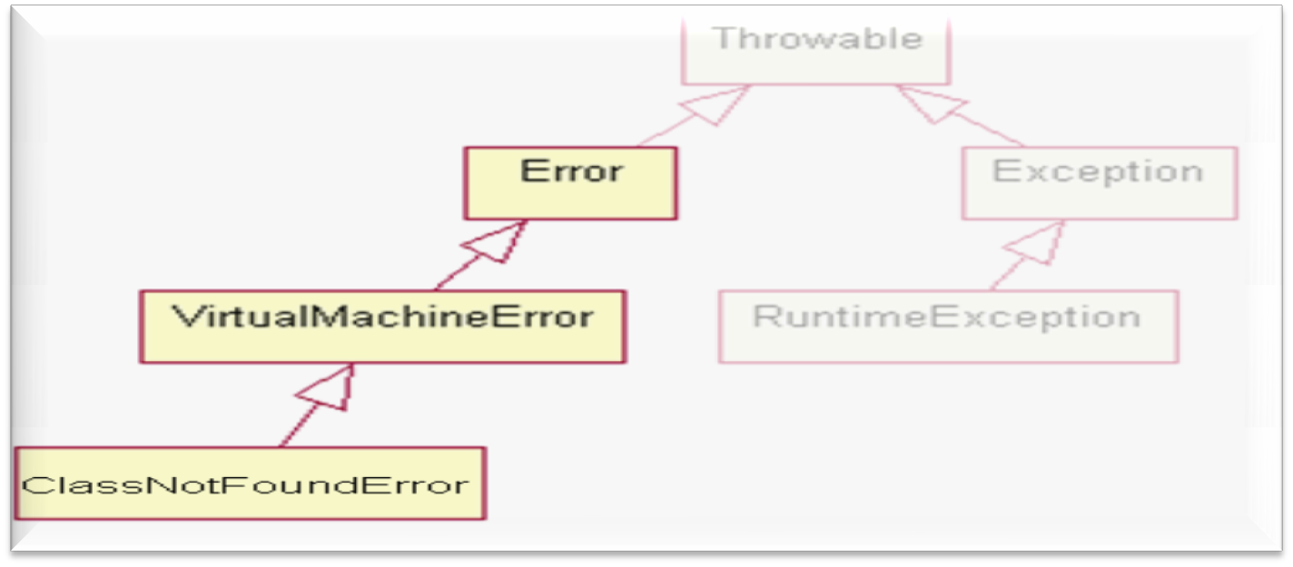
Errors
Exception Handling
Errors are exceptional conditions that are external to the application, and that the application cannot anticipate or recover from, therefore Errors are not handled by the application.
For example,
An application has to open a file and write to it, due to some hardware error, the application is unable to open the file we would get a java.io.IOError.

Slide 10
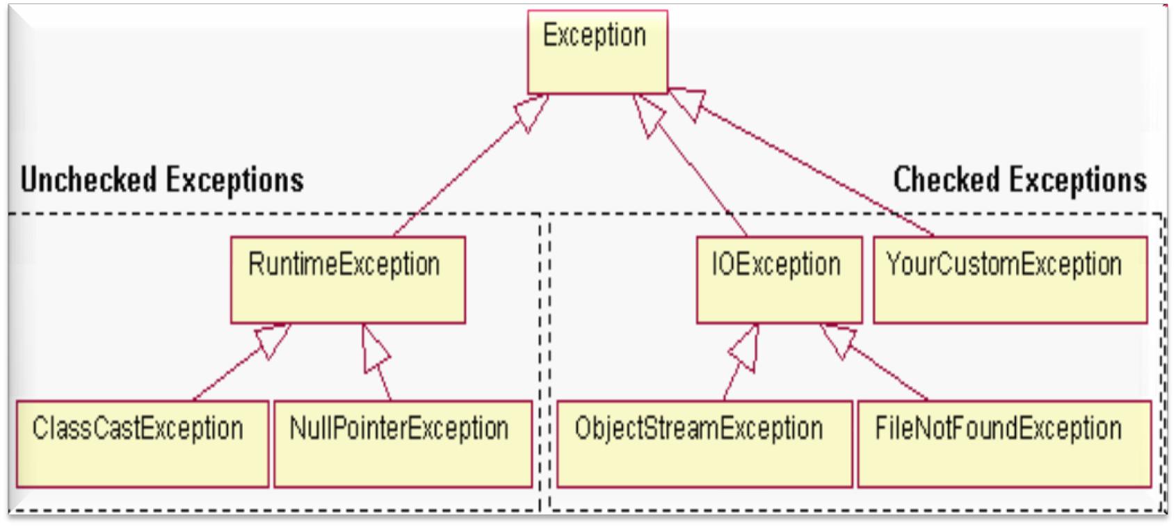
Types of Exception
Exception Handling
Exceptions are of 2 types
Checked exceptions
Unchecked or runtime exception

Slide 11
Types of Exception
Exception Handling
Checked exceptions
These are exceptional
conditions that a well written
application should anticipate and recover from.
Since these exceptions are anticipated and are recoverable conditions, compiler forces these exceptions to be handled.
e.g.: FileNotFoundException
Unchecked or runtime exception
These are exceptional conditions that are internal to the application, and that the application cannot anticipate or recover from.
These usually indicate programming bugs, such as logical errors or improper use of an API.
Since these can be fixed programmatically, compiler does not force these exceptions to be handled.
e.g.: NullPointerException

Slide 12

Throwing an Exception
Exception Handling
All methods use the throw statement to throw an
exception.
The throw statement requires a throwable object as argument. A throwable object are instances of any subclass of the Throwable class.
throw causes the method to terminate and returns an exception object to the caller.
public Object pop()
{
if(size == 0)
throw new EmptyStackException();
return objectAt(size--);
}

Slide 13
Exception Handlers
Exception Handling
Java programming language supports, exception handling by providing three exception handler components, these are
try
catch
finally
The try, catch and finally blocks are used to write an exception handler.

Slide 14

try Block
Exception Handling
Any code that might throw an exception is enclosed within a try block. It is the first step in constructing an exception handler.
A try block must be followed by at least by one catch block or one finally block.
try
{
code
………..
try block
}
catch and finally blocks……
Notes:
Notice point 2.

Slide 15

try Block Example
Exception Handling
public int countChars(String fileName) { int total = 0;
try {
FileReader r = new FileReader(fileName); while( r.ready()) {
r.read(); total++;
}
r.close();
}
catch……
}

Slide 16

Exception Handling
catch Block
A catch block is an exception handler associated with a try block and handles the type of exception indicated by its argument.
The argument type, indicates the type of exception that the handler can handle and must be the name of a class that inherits the Throwable class.
try
{
}
catch(ExceptionType name)
{
}
catch(ExceptionType name)
{
}
The catch block contains
code that is executed if and when the exception handler is invoked.
Every try block is associated
with
block
zero or more catch
and no code can be
between the end of try block and beginning of the first catch block.

Slide 17

catch Block Example
Exception Handling
public int countChars(String fileName) { int total = 0;
try {
FileReader r = new FileReader(fileName); while( r.ready()) {
r.read(); total++;
}
r.close();
}
catch(FileNotFoundException e){
System.out.println("File named " + fileName + "not found. " +e); total = -1;
}
catch(IOException e){
System.out.println("IOException occured "+ "while counting " +e); total = -1;
}
}
See listing : ExceptionDemo1.java

Slide 18

finally Block
Exception Handling
A finally block is executed irrespective of whether
the try block throws an error or not.
finally block is guaranteed to be executed and can be used for any clean-up code.
If no catch block matches an exception thrown, control is transferred to the finally block.
There can be only one finally block for a try block.
try{
}
catch(ExceptionType name){
}
finally{
}
Notes:
Statement 3 is not true. In all cases control will got to finally if try executed…

Slide 19

finally Block Example
Exception Handling
public int countChars(String fileName) {
int total = 0;
FileReader r = new FileReader(fileName); try {
while( r.ready()) { r.read(); total++;
}
}
catch(FileNotFoundException e){
System.out.println("File named " + fileName + "not found. " + e); total = -1;
}
catch(IOException e){
System.out.println("IOException occured "+ "while counting " + e); total = -1;
}
finally {
r.close();
}
Clean up code goes into finally block
}
See listing : ExceptionDemo2.java

Slide 20

StackTrace
Exception Handling
public static void main(String[ ] args) {
try {
method1(); method2(); method3();
……………
……………
try block has several method calls which can throw an exception
Use the printStackTrace() method, to trace the origin of the Exception
}
catch(Exception e) { e.printStackTrace();
}
}
See listing : StackTraceDemo.java
Notes:
If you not handle exception then program will terminate with exception message but it is for first point of error or exception, rest of the line of code will not execute. where as in exception handled code it will not let your program to terminate in middle of any exception occurred it will continue to the end so that if 10 places error occurred with handle error message you will come to know where and all error occurred and at a time you can fix all of them.no need to run the program multiple time for identified all error one by one.

Slide 21

Exception Handling
Specifying a method as throwing Exception
public void writeList() {
writeList() method can
throw an IOException or
PrintWriter out = new PrintWriter(neAwrrayIndexOutOfBounds
FileWriter(“outputF^{E}il^{x}e^{c}.t^{e}x^{p}t^{t}”^{i})º)^{n};
for(int i=0 ; i<SIZE ; ++i)
out.println(“Value at” + vector.elementAt(i)); out.close();
}
The writeList() method can anticipate an exception and catch the same.
The method however need not catch the exception and thereby allow a method further up the call stack to handle it.
In that scenario the method has to specify the exception being thrown by the method.

Slide 22

Specifying a method as throwing Exception
Exception Handling
A method can specify to throw an exception by
adding a throws clause to the method declaration.
The throws clause comprises the throws keyword followed by a comma-separated list of all the exceptions thrown by that method.
The clause goes after the method name and argument list and before the brace that defines the scope of the method.
public void writeList() throws IOException ,
ArrayIndexOutOfBoundsException {
}
Here ArrayIndexOutOfBoundsException is an unchecked exception, including it in the throws clause is not mandatory.

Slide 23


User defined Exceptions
Exception Handling
Java platform provides a lot of exception classes for use,
programmer
his own exception class.
If an exception cannot be represented by those in the Java platform, a user can define his own exception.
This exception class should be a subclass of the Exception class or any of its subclass.
public class ProductNotFoundException extends Exception
{
}
public Product getProducts() throws ProductNotFoundException {
………
………
}
else the
can write

Slide 24
Method overriding and Exceptions
Exception Handling
The checked exception classes named in the throws clause are part of the contract between the implementer and user of the method or constructor.
The throws clause of overriding method can specify all or none of the exception classes specified in the throws clause of the overridden method in the super class.
The overriding method may not specify that this method will result in throwing any checked exception which the overridden method is not permitted.
However the overriding method can throw exceptions which are subclasses of the exceptions in the throws clause of the overridden method.
Notes:
For this go for Lara material. while overriding you can override without having throws exception even if super class method have throws exception.
And if I has then it can be same or subclass of super class method except

Slide 25
Exercise
Exception Handling
Create a class with a main( ) that throws an object of class Exception inside a try block. Give the constructor for Exception a String argument. Catch the exception inside a catch clause and print the String argument. Add a finally clause and print a message to prove you were there.
See ExceptionExercise.doc

Slide 26

What is an Assertion?
Exception Handling
An assertion is a statement in Java that enables you to test the assumptions about your program.
Assertions are one of the quickest and most effective ways to detect and correct bugs at development time.
Each assertion contains a boolean expression that you believe will be true when the assertion executes. If its not true, the system will throw an error.
By verifying that the boolean expression is indeed true, the assertion confirms the assumptions about the behavior of the program, thereby validating the program to be free of errors.
public class MyClass {
public void aMethod() { Employee emp = null;
//Get a Employee object
//Check to ensure we have one
assert emp != null;
}
}
One of the most important features of this facility is that these checks can be turned on and off at runtime.

Slide 27

Simple Assertion Form
Exception Handling
The assertion statement has two forms
The first is:
assert Expression1 ;
Where Expression1 is a boolean expression
▪
When the system runs the assertion,
it evaluates Expression1 and if it is false throws an
AssertionError with no detail message.
public void display(String empId) { Employee emp = getEmployee(empId); assert emp != null;
System.out.println(“Employee name “+emp.getName()); System.out.println(“Employee address “+emp.getAddress());
}

Slide 28

Exception Handling
Complex Assertion Form
The second form of the assertion statement is:
assert Expression1 : Expression2 ;
where:
Expression1 is a boolean expression
Expression2 is an expression that has a value
Expression2 cannot be invocation of a method that returns void. It can be an object, boolean, char, int, long, float or double.
p▪ubUliscevtohidisdviesrpslaioyn(Sotfritnhge eamsspeIdrt)s{tatement to provide a detailed
message for the AssertionError
Employee emp = getEmployee(empId);
The system passes the value of Expression2 to the appropriate
assert emp != null : “Employee object not found “;
AssertionError constructor, which uses the string representation of the vSayluseteams.othuet.perrirnotrln’s(“dEemtapillomyeeessnaagme.e “+emp.getName());
^{Th}S^{e}y^{p}st^{u}e^{r}m^{po}.o^{s}u^{e}t.ºp^{f}ri^{t}n^{h}t^{e}ln^{m}(“E^{es}m^{s}pªl^{g}o^{e}ye^{is}e ^{t}aºd^{c}dªre^{p}s^{tu}s^{re}“+ªe^{n}m^{d}p^{c}.gºe^{m}tA^{m}d^{u}d^{n}re^{ic}sªs^{t}(^{e}))^{t};^{he} details of the assertion failure and will allow to diagnose and fix the
}error.

Slide 29
Compiling files that use Assertions
Exception Handling
In order for the javac compiler to accept code containing assertions, use the –source 1.4 command-line option.
Example
javac –source 1.4 MyClass.java
Assertions were introduced from J2SE 1.4, so the flag is a must and necessary so as to not cause source compatibility problems.
See listing : AssertionDemo.java

Slide 30
Enabling and Disabling Assertions
Exception Handling
By default, assertions are disabled at runtime. Two command line switches allow to selectively enable or disable assertions.
To enable assertions at various granularities, use the
-enableassertions, or –ea , switch
To disable assertions at various granularities,
use the
-disableassertions, or -da, switch
Specify the granularity with the arguments that you provide to the switch

Slide 31
Arguments
Exception Handling
no arguments
Enables or disables assertions except system classes
packageName... Enables or disables assertions
in all classes
in the named
package and any subpackages
▪ ...
Enables or disables assertions in the unnamed package in the current working directory
className
Enables or disables assertions in the named class

Slide 32
Where to use Assertions
Exception Handling
The assert construct is not a full-blown design-by-
contract facility, it can help support design-by-contract style of programming.
Assertions can be used for –
an informal
Preconditions
invoked.
Postconditions
– what must be true when
a method is
– what must be true after a method
completes successfully.
Class invariants – what must be true about each instance of
a class.
We will look at each of the conditions with an example of a integer stack which provides operations such as push to add an item and pop to retrieve an item from stack.
Notes:
Refer to Lara Material.

Slide 33

Preconditions
Exception Handling
To withdraw
amount
from
an account the
presented amount should not be negative. This precondition can be programmed using assertions as follows
public void withdraw(int amount)
{
//precondition
assert amount >0 : “Amount negative“;
…….
}

Slide 34

Postconditions
Exception Handling
After successful withdrawal the balance should have reduced. This post condition can be programmed using assertions as follows
public void withdraw(int amount) { int oldBalance = balance; if(balance > amount)
balance -= amount;
assert balance < oldBalance : “balance never changed“;
…….
}

Slide 35

Class Invariants
Exception Handling
A class invariant is a condition that must be true
before and after any method completes.
In the Account example, at any point of time the balance should be greater than mini balance. These conditions, can be coded as follows.
public void withdraw(int amount) {
……..
assert balance > miniBalance : “balance less than min balance“;
…….
}

Slide 36
Where not to use Assertions?
Exception Handling
There are also a few situations where you should not
use them:
Do not use assertions for argument checking in public methods.
enabled or disabled.
Erroneous arguments should result in an appropriate runtime exception (such as IllegalArgumentException, or NullPointerException). An assertion failure will not throw an appropriate exception.
Do not use assertions to do any work that your
Argument checking
is typically part of the published
specifications (or contract) of
a method, and these
specifications must be obeyed
whether assertions are
application requires for correct operation.
Since assertions may be disabled, programs must not assume that the boolean expression contained in an assertion will be evaluated. Violating this rule has dire consequences.

Slide 37

Exception Handling
Question time
Please try to limit the questions to the topics discussed during the session. Participants are encouraged to discuss other issues during the breaks.
Thank you.

